Slide 1
Introduction to Parallel Programming with CUDA
From CPU Divide and Conquer to GPU Algorithms

Slide 2
CPU Binary Search in C++
#include <bits/stdc++.h>
using namespace std;
// A recursive binary search function. It returns location of x in given array, otherwise -1
int binarySearch(int arr[], int l, int r, int x)
{
if (r >= l) {
int mid = l + (r - l) / 2;
// If the element is present at the middle itself
if (arr[mid] == x)
return mid;
// If element is smaller than mid, then only be present in left subarray
if (arr[mid] > x)
return binarySearch(arr, l, mid - 1, x);
// Else the element in right subarray
return binarySearch(arr, mid + 1, r, x);
}
// We reach here when element is not in array
return -1;
}
int main(void)
{
int arr[] = { 2, 3, 4, 10, 40 };
int x = 10;
int n = sizeof(arr) / sizeof(arr[0]);
int result = binarySearch(arr, 0, n - 1, x);
(result == -1) ? cout << "Element is not present in array"
: cout << "Element is present at index " << result;
return 0;
}
[1]

Slide 3
Distributed Search in CUDA
__global__ void search(const float *input, const int x, int *index)
{
if(input[threadIdx.x] == x) {
*index = threadIdx.x;
}
}
int main()
{
const int N = 256000;
float *h_data[N];
int index = -1;
int x= rand() % N;
for(int i = 0; i < N; i++) {
h_data[i] = i;
}
float *d_data[N];
int *d_i;
cudaMalloc((void **) &d_data, N*sizeof(int));
cudaMalloc((void **) &d_i, sizeof(int); cudaMemcpy(&h_data, d_data, N*sizeof(int), cudaMemcpyHostToDevice);
cudaMemcpy(&index, d_i, sizeof(int), cudaMemcpyHostToDevice);
search<<<1, 1>>> (d_data, x, d_i);
cudaMemcpy(&index, d_i, sizeof(int), cudaMemcpyDeviceToHost);
}
[2]

Slide 4
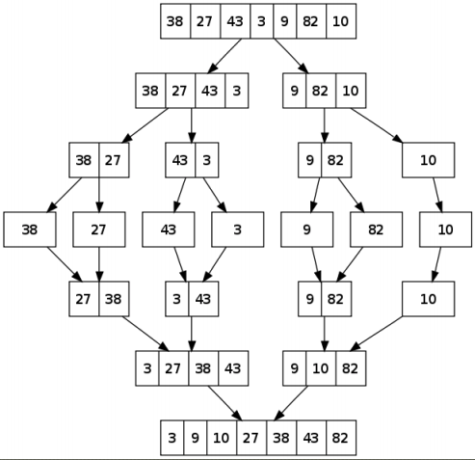
MergeSort

Slide 5
CPU Merge in C++
// Merge two subarrays L and M into arr
void merge(int arr[], int p, int q, int r) {
// Create L ← A[p..q] and M ← A[q+1..r]
int n1 = q - p + 1;
int n2 = r - q;
int L[n1], M[n2];
for (int i = 0; i < n1; i++)
L[i] = arr[p + i];
for (int j = 0; j < n2; j++)
M[j] = arr[q + 1 + j];
// Maintain current index of sub-arrays and main array
int i, j, k; i = 0; j = 0; k = p;
// Until we reach either end of either L or M, pick larger among
// elements L and M and place them in the correct position at A[p..r]
while (i < n1 && j < n2) {
if (L[i] <= M[j]) {
arr[k] = L[i]; i++;
} else {
arr[k] = M[j]; j++;
}
k++;
}
// When we run out of elements in either L or M,
// pick up the remaining elements and put in A[p..r]
while (i < n1) {
arr[k] = L[i];
i++;
k++;
}
while (j < n2) {
arr[k] = M[j]; j++; k++;
}
}
[3]

Slide 6
CPU MergeSort in C++
// Divide the array into two subarrays, sort them and merge them
void mergeSort(int arr[], int l, int r) {
if (l < r) {
// m is the point where the array is divided into two subarrays
int m = l + (r - l) / 2;
mergeSort(arr, l, m);
mergeSort(arr, m + 1, r);
// Merge the sorted subarrays
merge(arr, l, m, r);
}
}
[3]

Slide 7
CUDA Merge
__device__ void gpu_bottomUpMerge(long* source, long* dest, long start,
long middle, long end)
{
long i = start;
long j = middle;
for (long k = start; k < end; k++) {
if (i < middle && (j >= end || source[i] < source[j])) {
dest[k] = source[i];
i++;
} else {
dest[k] = source[j];
j++;
}
}
}
[4]

Slide 8
CUDA MergeSort
__global__ void gpu_mergesort(long* source, long* dest, long size, long width, long slices, dim3* threads, dim3* blocks)
{
unsigned int idx = threadIdx.x +
threadIdx.y * (x = threads->x) +
threadIdx.z * (x *= threads->y) +
blockIdx.x * (x *= threads->z) +
blockIdx.y * (x *= blocks->z) +
blockIdx.z * (x *= blocks->y);
long start = width*idx*slices,
middle,
end;
for (long slice = 0; slice < slices; slice++) {
if (start >= size)
break;
middle = min(start + (width >> 1), size);
end = min(start + width, size);
gpu_bottomUpMerge(source, dest, start, middle, end);
start += width;
}
}
[4]

Slide 9
Bibliography
[1] 2021. GeeksforGeeks. Binary-search. Retrieved from https://www.geeksforgeeks.org/binary-search/.
[2] 2019. Kubriienko, Oleksii. Apriorit. Using CUDA to Accelerate the Algorithms to Find the Maximum Value in a Range with CPU and GPU. Retrieved from https://www.apriorit.com/dev-blog/614-cpp-cuda-accelerate-algorithm-cpu-gpu.
[3] 2021. Programiz.com. Merge Sort. Retrieved from https://www.programiz.com/dsa/merge-sort.
[4] 2014. Albert, Kevin. GitHub. cuda-mergesort. Retrieved from https://github.com/kevin-albert/cuda-mergesort.

